Slide 1


Slide 2

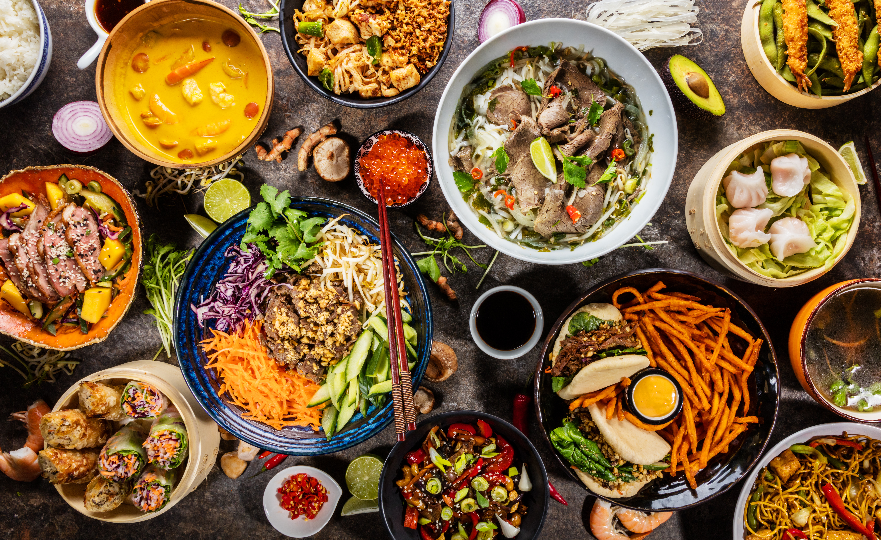
ROUND 1: FOOD & DRINK
GUESS THE DISH

Slide 3

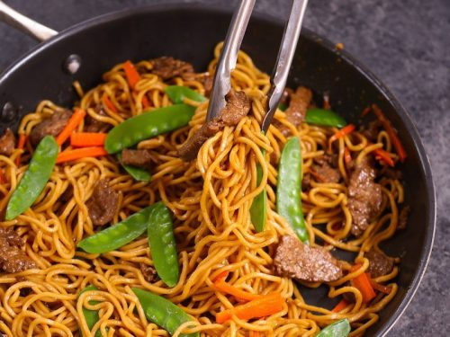
1. WHAT IS THIS FRIED DISH?
A) BEEF LO MEIN
B) BEEF CHOW MEIN
C) BEEF WITH NOODLES
D) BEEF WITH VEGETABLES

Slide 4
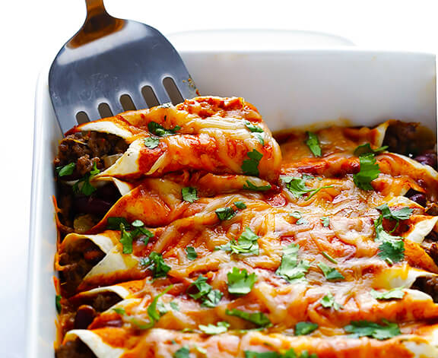
2. Name this popular Mexican dish
A) FAJITAS
B) ENCHILADAS
C) QUESEDILLA
D) CHILLI CON CARNE

Slide 5
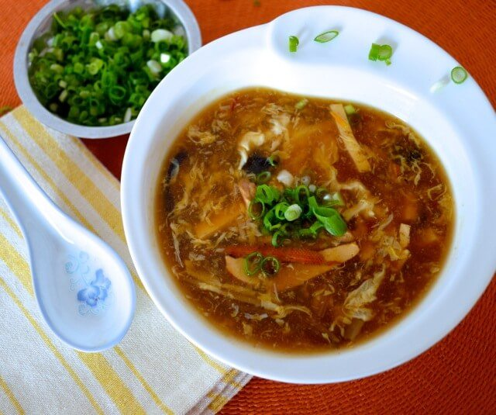
3. WHICH CHINESE SOUP IS THIS?
A) EGG DROP
B) WON TON
C) PHO
D) HOT AND SOUR

Slide 6
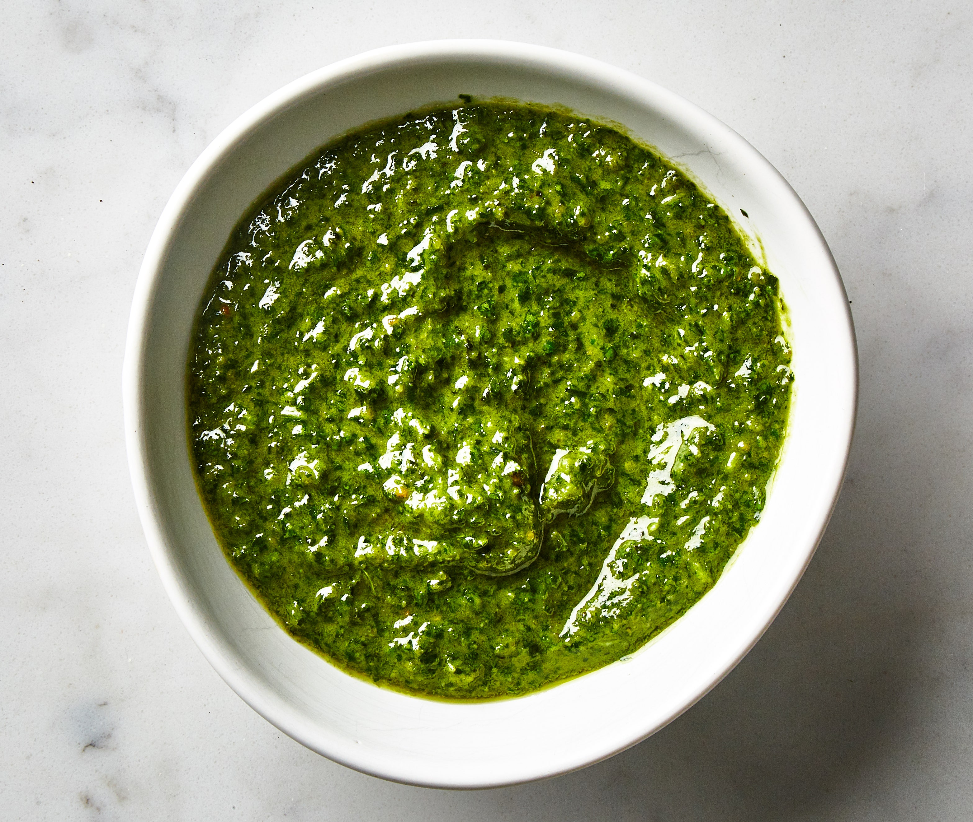
4. WHAT ITALIAN CITY IS THE ORIGIN OF PESTO?
A) GENOA
B) ROME
C) MILAN
D) TERNI

Slide 7
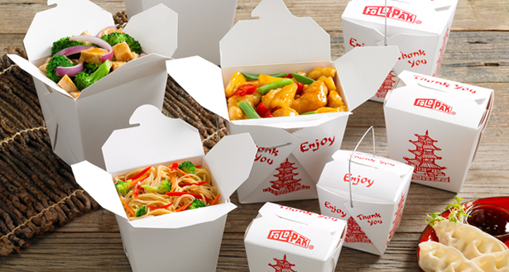
5. WHAT WAS THIS BOX INVENTED FOR?
A) TO HOLD CHINESE FOOD
B) TO HOLD JAPANESE TAKEOUT
C) TO HOLD VEGETABLES
D) TO HOLD OYSTERS

Slide 8
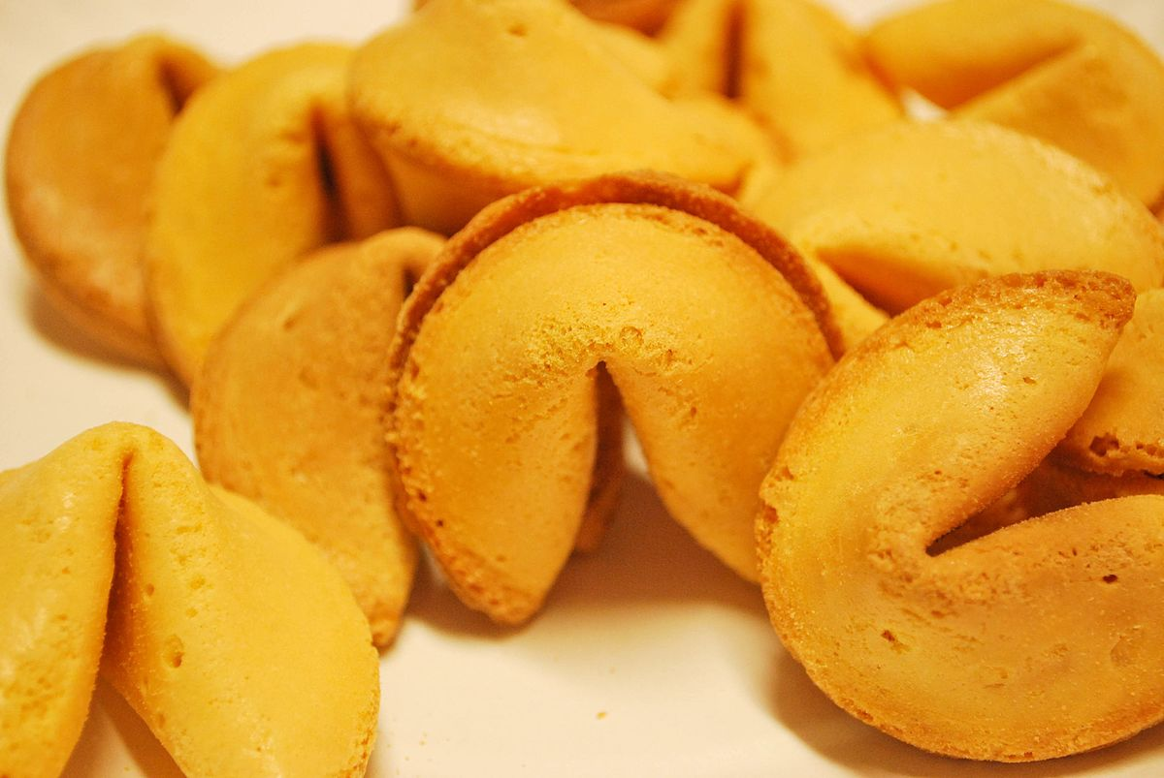
6. WHAT IS THE ORIGIN OF THIS COOKIE?
A) CHINA
B) JAPAN
C) CALIFORNIA
D) HAWAII

Slide 9
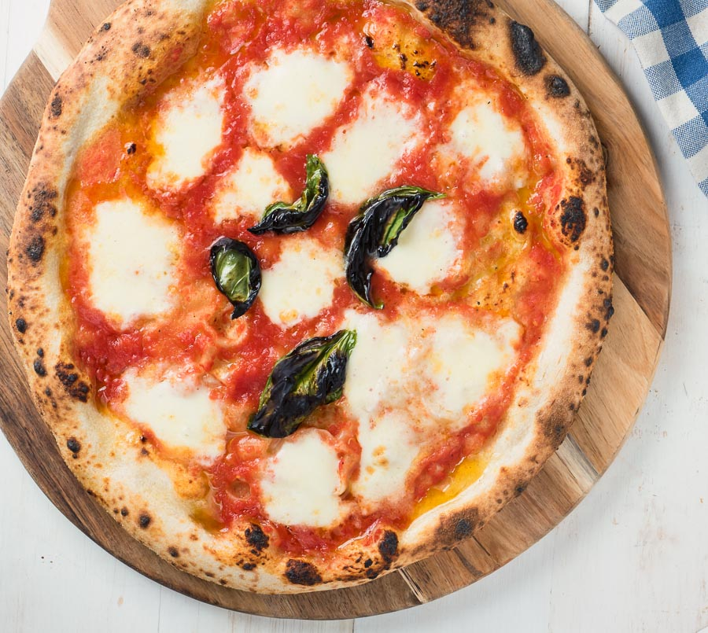
7. How many slices of pizza are eaten in the usa every second?
A) 25
B) 1250
C) 200
D) 350

Slide 10
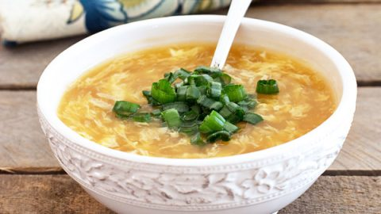
8. WHICH SOUP IS THIS?
A) HOT AND SOUR
B) WONTON
C) EGG DROP
D) ONION

Slide 11
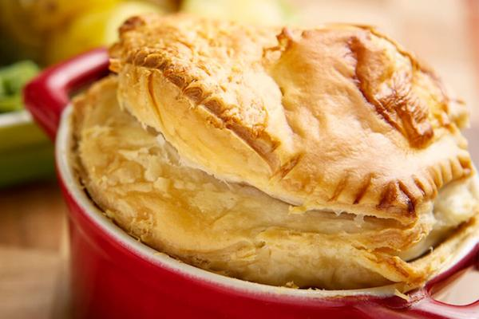
9. IN WHAT ERA WAS THE PIE INVENTED?
A) GEORGIAN
B) VICTORIAN
C) ROMAN
D) EDWARDIAN

Slide 12
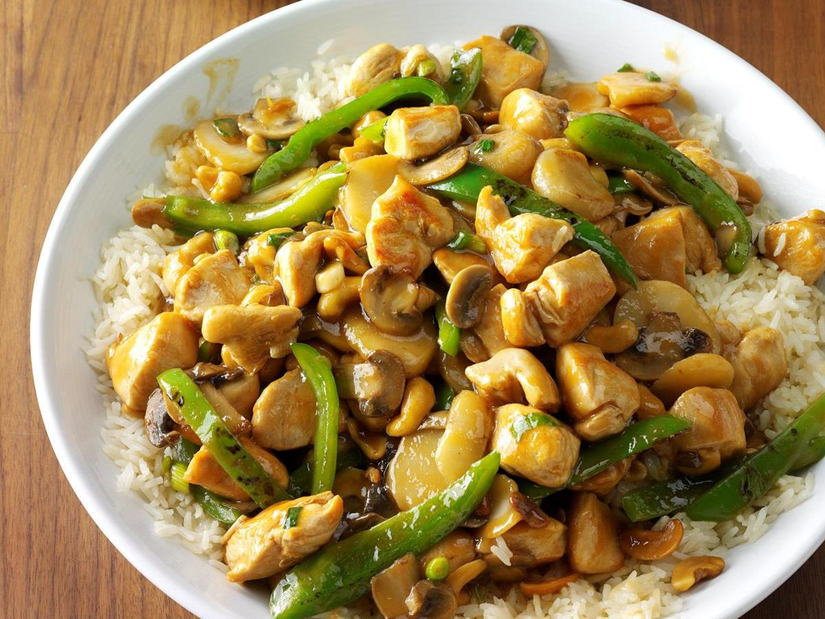
10. THIS DISH WAS CREATED IN AMERICA IN AN UNLIKELY PLACE. WHAT IS IT?
A) MOO GOO GAI PAN
B) CASHEW CHICKEN
C) CHICKEN CANTONESE
D) SESAME CHICKEN

Slide 13
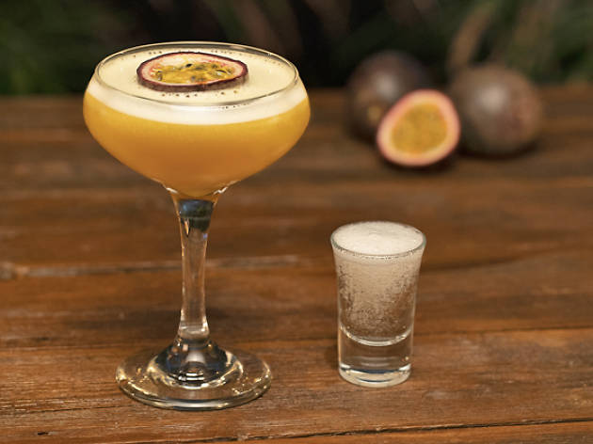
11. NAME THE COCKTAIL
A) MANGO COLLINS
B) PEACH BELLINI
C) PORNSTAR MARTINI
D) COSMOPOLITAN

Slide 14
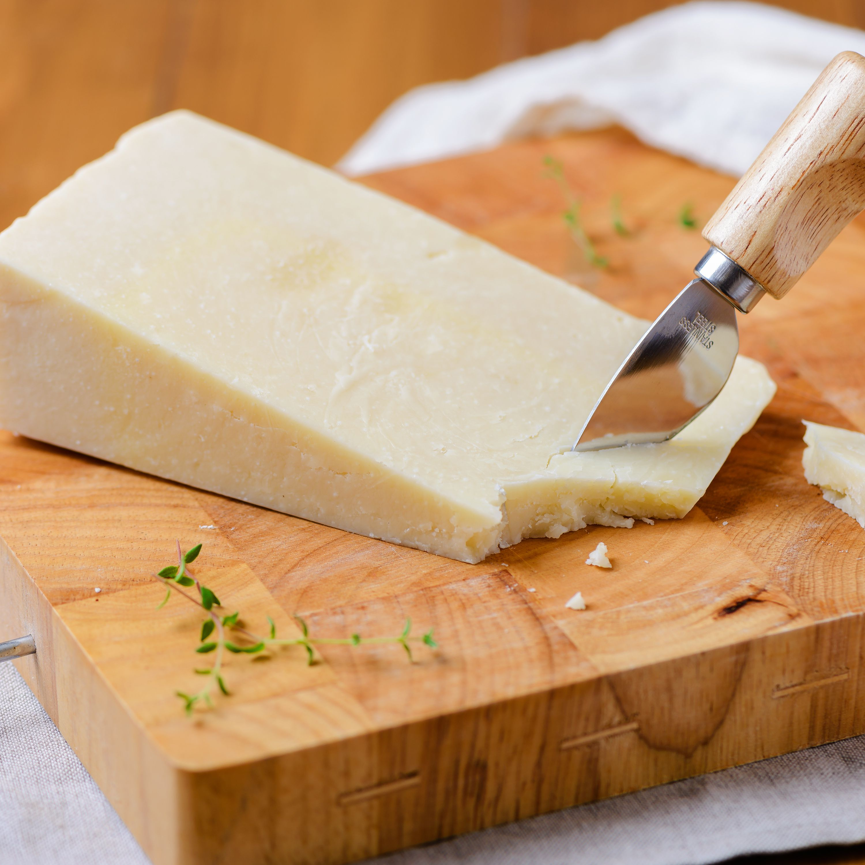
12. HOW MANY POUNDS OF MILK DOES IT TAKE TO MAKE 1 POUND OF CHEESE?
A) 1 POUND
B) 5 POUNDS
C) 10 POUNDS
D) 25 POUNDS

Slide 15
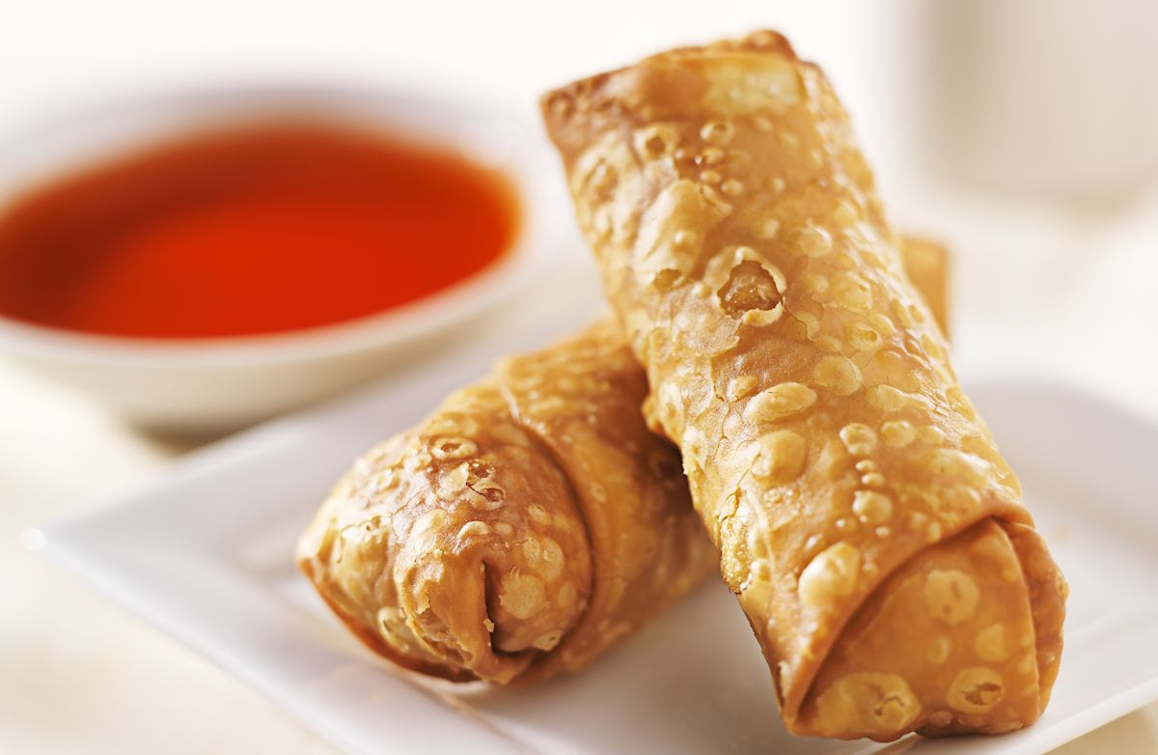
13. WHAT IS THIS FRIED APPETISER?
A) SPRING ROLL
B) SUMMER ROLL
C) EGG ROLL
D) WONTON ROLL

Slide 16
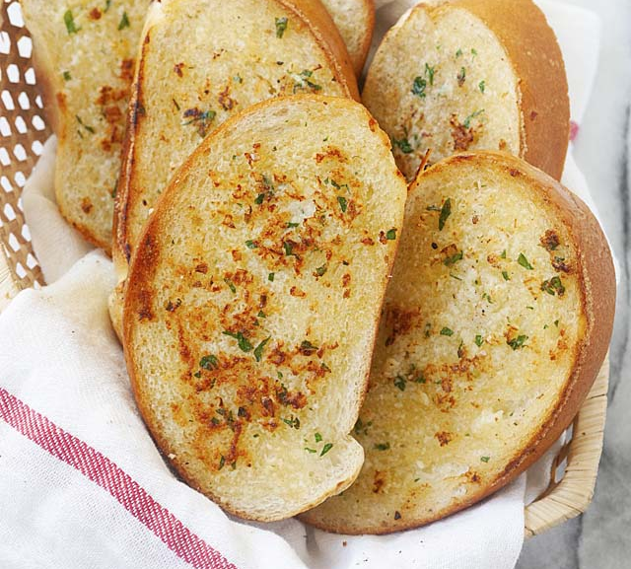
14. NAME THIS FAMOUS TYPE OF BREAD
A) BRUCHETTA
B) GARLIC BREAD
C) TOASTED BAGUETTE
D) SOUR DOUGH

Slide 17
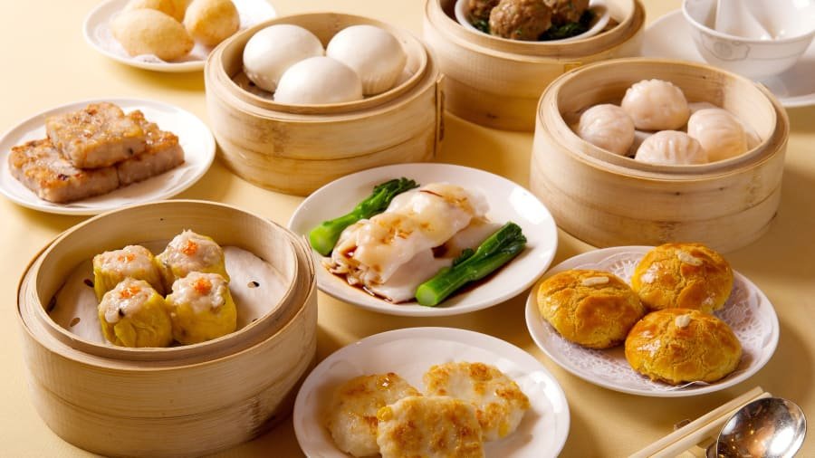
15. WHAT IS THIS FEAST CALLED?
A) PUPU PLATTER
B) CHINESE BUFFET
C) TAPAS
D) DIM SUM

Slide 18
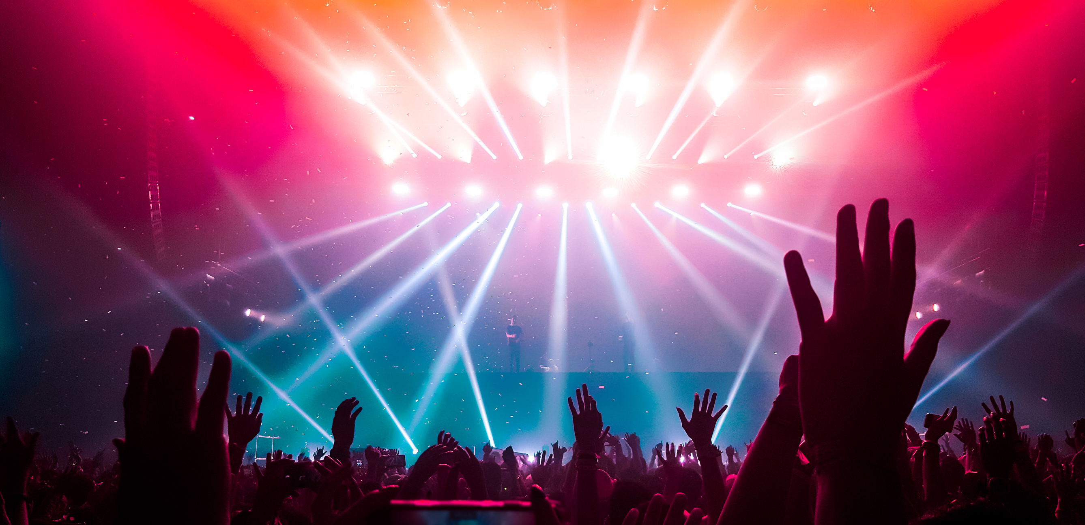
ROUND 2: FINISH THE LYRICS
LOCKDOWN SPECIAL

Slide 19
“AND SO YOU’RE BACK FROM OUTER SPACE…
I JUST WALKED INTO FIND YOU HERE WITH THAT SAD LOOK UPON YOUR FACE…
I SHOULD HAVE CHANGED THAT STUPID LOCK…
I SHOULD HAVE MADE YOU LEAVE YOUR KEY…
IF I’D KNOWN FOR JUST ONE SECOND YOU’D BE BACK TO BOTHER ME…”

Slide 20
“WE’LL MEET AGAIN, DON’T KNOW WHERE, DON’T KNOW WHEN…
BUT I KNOW WE’LL MEET AGAIN SOME SUNNY DAY…
KEEP SMILING THROUGH, LIKE YOU ALWAYS DO…
‘TIL THE BLUE SKIES DRIVE THE DARK CLOUDS FAR AWAY…”

Slide 21
“WHEN I WAS YOUNG, I NEVER NEEDED ANYONE…
AND MAKING LOVE WAS JUST FOR FUN…
THOSE DAYS ARE GONE…
LIVING ALONE, I THINK OF ALL THE FRIENDS I’VE KNOWN…
BUT WHEN I DIAL THE TELEPHONE, NOBODY’S HOME…”

Slide 22
“BABY CAN’T YOU SEE, I’M CALLING…
A GUY LIKE YOU SHOULD WEAR A WARNING…
IT’S DANGEROUS, I’M FALLING…
THERE’S NO ESCAPE, I CAN’T WAIT…
I NEED A HIT, BABY GIVE ME IT…
YOU’RE DANGEROUS, I’M LOVING IT…”

Slide 23
“I’M IN THE CORNER, WATCHING YOU KISS HER, OHH…
I’M RIGHT OVER HERE, WHY CAN’T YOU SEE ME, OHH…
I’M GIVING IT MY ALL, BUT I’M NOT THE GIRL YOU’RE TAKING HOME…
I KEEP DANCING ON MY OWN…”

Slide 24
“WHERE ARE THOSE HAPPY DAYS, THEY SEEM SO HARD TO FIND…
I TRY TO REACH FOR YOU BUT YOU HAVE CLOSED YOUR MIND…
WHATEVER HAPPENED TO OUR LOVE? I WISH I UNDERSTOOD…
IT USED TO BE SO NICE, IT USED TO BE SO GOOD…”

Slide 25
“LONELY, I’M MR LONELY…
I HAVE NOBODY FOR MY OWN…”

Slide 26
“OH YEAH, I’LL TELL YOU SOMETHING…
I THINK YOU’LL UNDERSTAND…
WHEN I SAY THAT SOMETHING…
I WANT TO HOLD YOUR HAND…”

Slide 27
“MY, MY, MY MUSIC HITS ME SO HARD…
MAKES ME SAY, “OH MY LORD”…
THANK YOU FOR BLESSING ME…
WITH A MIND TO RHYME AND TWO HYPE FEET…”

Slide 28
“YOU THOUGHT I WOULDN’T GROW WITHOUT YOU, NOW I’M WISER…
YOU THOUGHT THAT I’D BE HELPLESS WITHOUT YOU BUT I’M SMARTER…
YOU THOUGHT THAT I’D BE STRESSED WITHOUT YOU BUT I’M CHILLIN’…
YOU THOUGHT I WOULDN’T SELL WITHOUT YOU, SOLD NINE MILLION…”

Slide 29
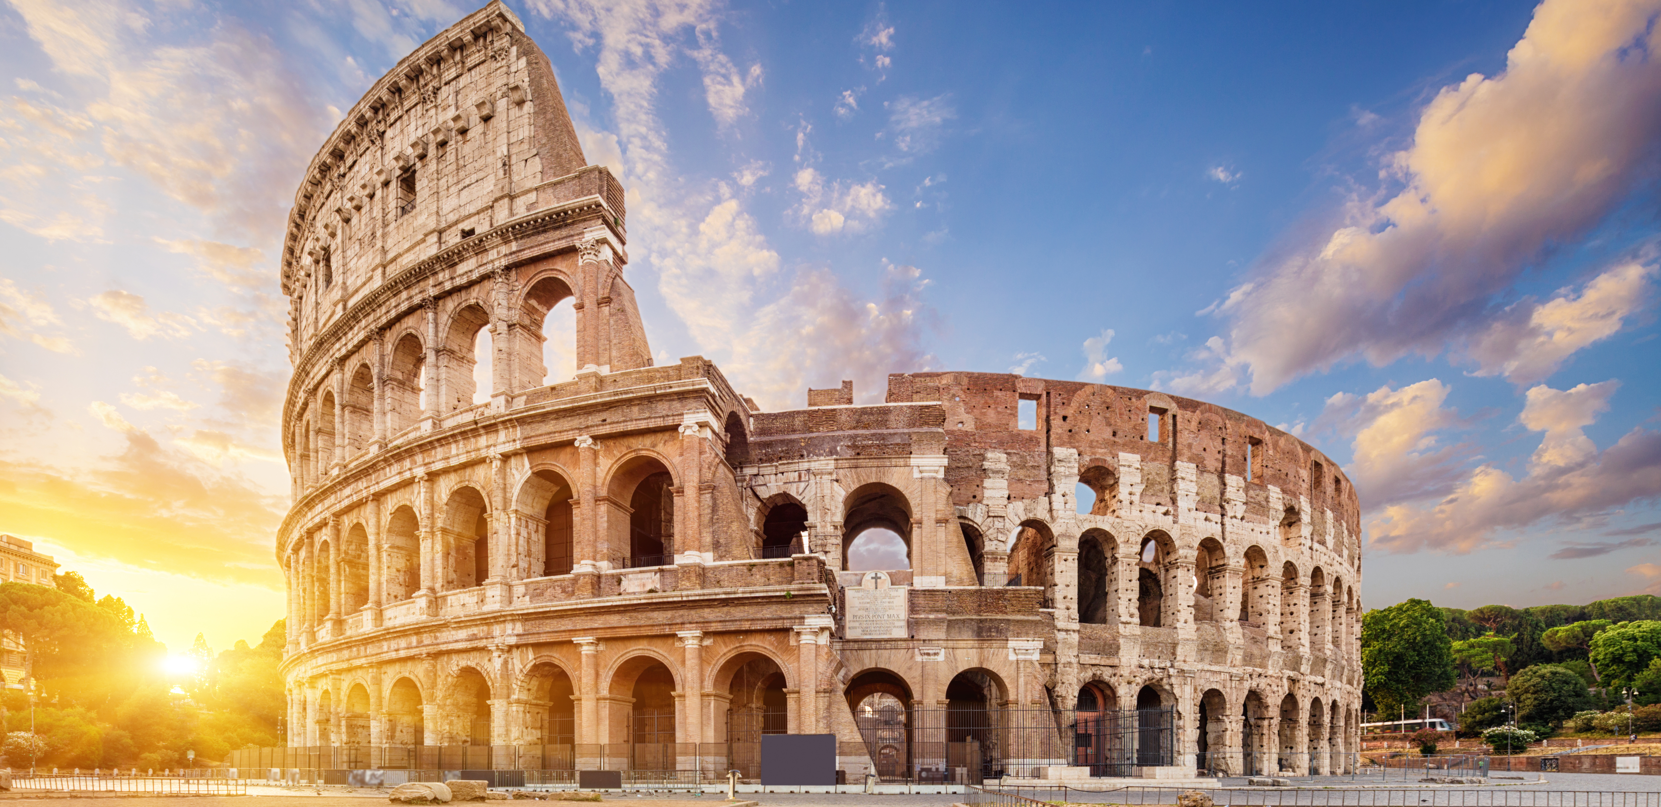
ROUND 3: GEOGRAPHY
FAMOUS LANDMARKS

Slide 30
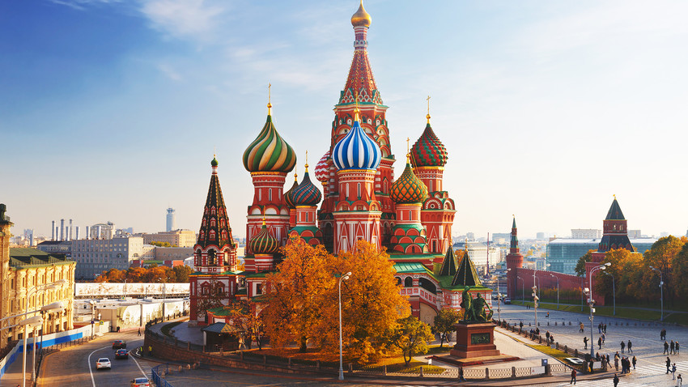
1. WHERE IS ST. BASIL’S CATHEDRAL?

Slide 31
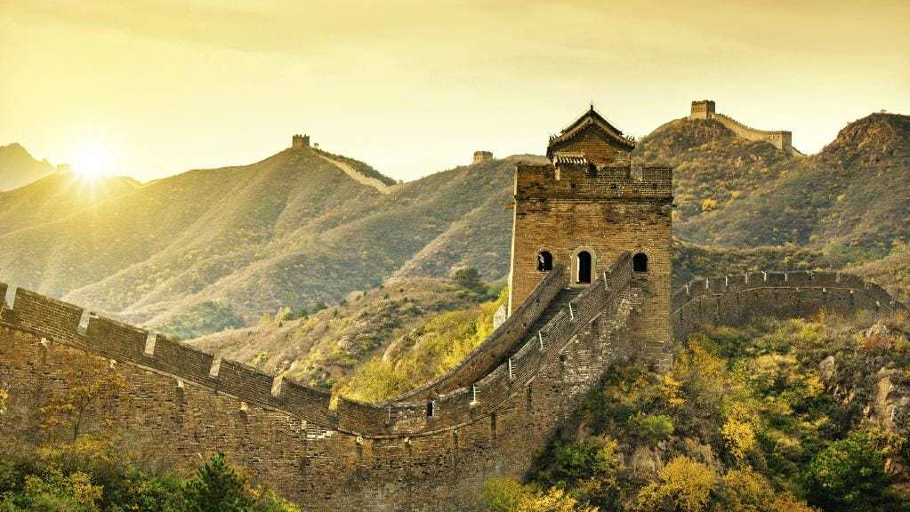
2. HOW LONG IS THE GREAT WALL OF CHINA?
A) 132 MILES
B) 554 MILES
C) 2456 MILES
D) 13,171 MILES

Slide 32
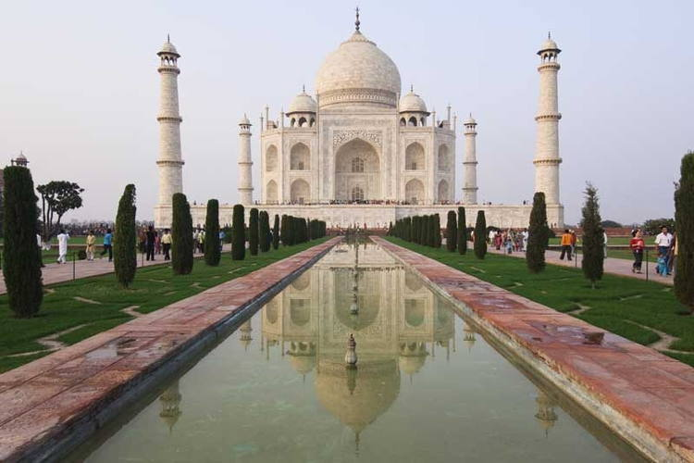
3. WHY WAS THE TAJ MAHAL BUILT?
A) TO HONOUR A DECEASED PERSON
B) TO SERVE AS A RELIGIOUS PILGRIMAGE SITE
C) FOR POLITICAL REASONS
D) AS A SHOW OF POWER

Slide 33
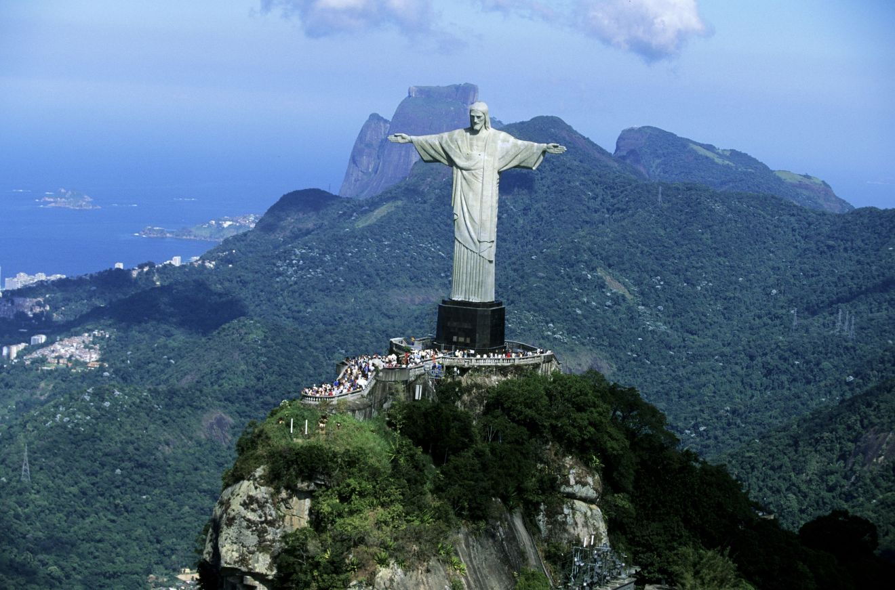
4. WHAT CITY DOES CHRIST THE REDEEMER SOAR OVER?

Slide 34
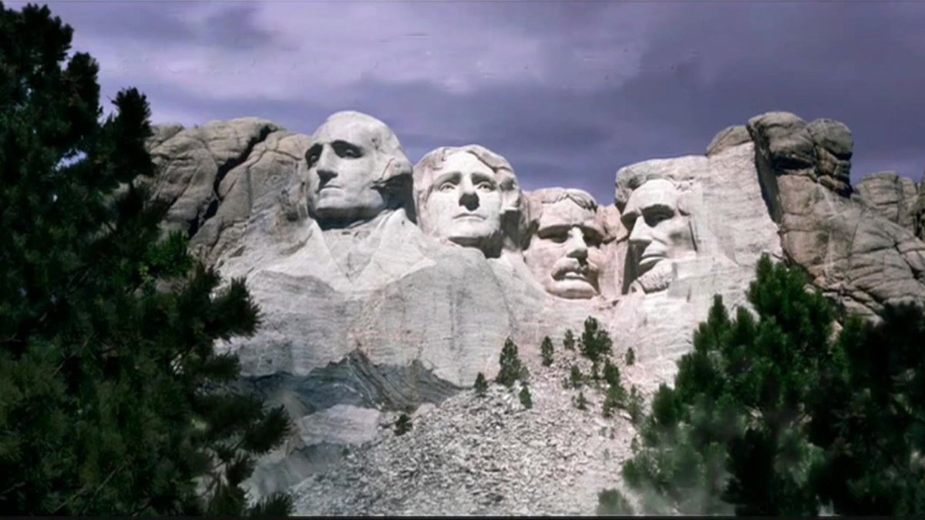
5. What state is mount rushmore in?
A) MONTANA
B) NORTH DAKOTA
C) NEBRASKA
D) SOUTH DAKOTA

Slide 35
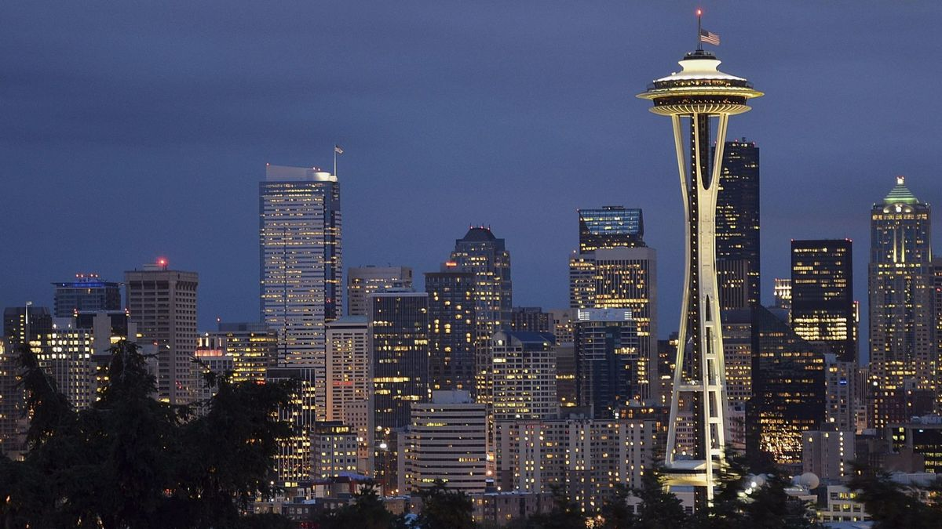
6. WHY WAS THE SPACE NEEDLE IN SEATTLE CREATED?
A) FOR A FAIR
B) FOR A RECORD COMPANY
C) TO COMMUNICATE WITH ASTRONAUTS
D) TO BETTER SEE ALIEN AIRCRAFT IN THE PACIFIC

Slide 36
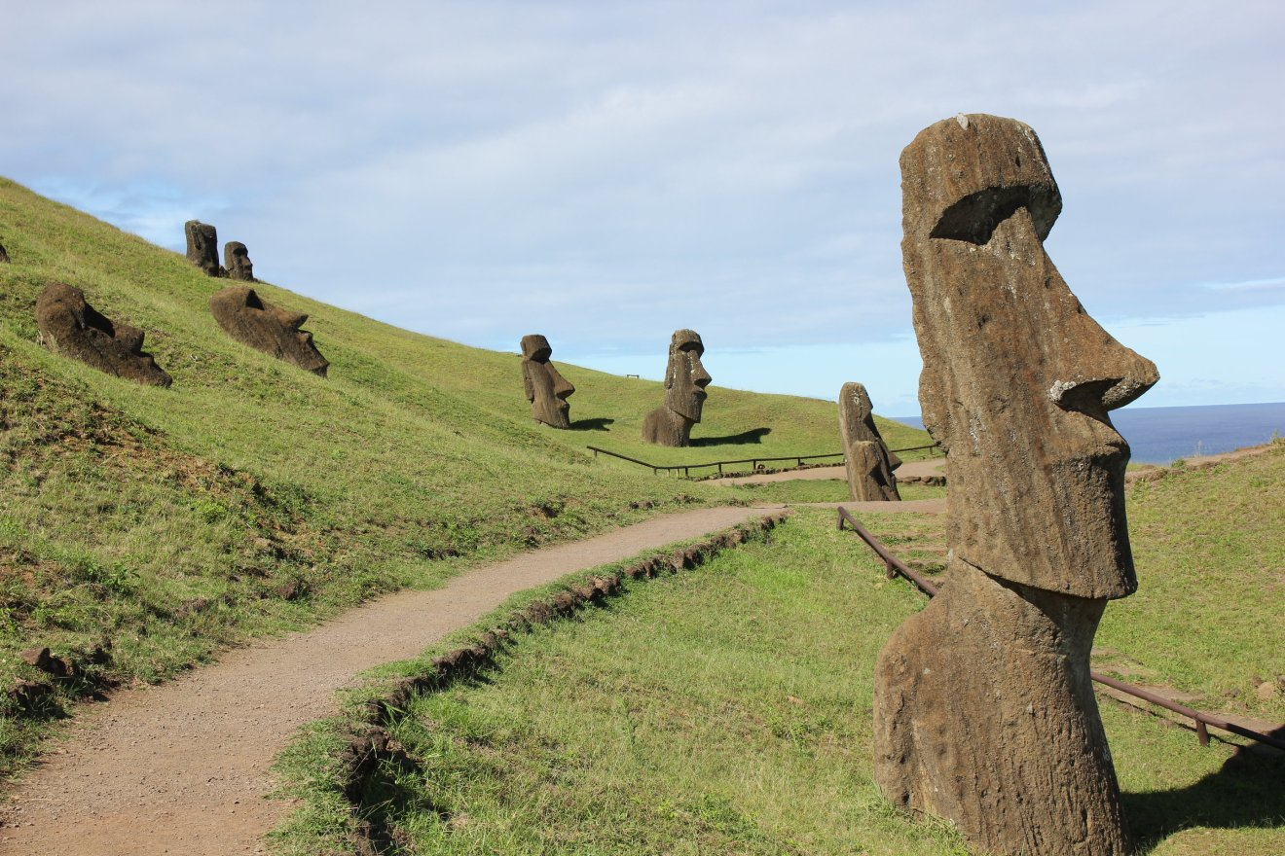
7. WHAT HOLIDAY SHARES A NAME WITH THE ISLAND WHERE THESE STATUES RESIDE?
A) EASTER
B) CHRISTMAS
C) NEW YEAR’S
D) SOLSTICE

Slide 37
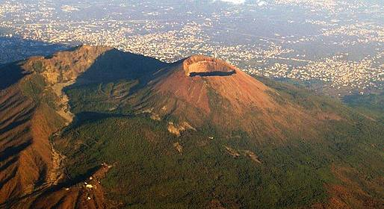
8. WHAT IS THE NAME OF THIS MOUNT?

Slide 38
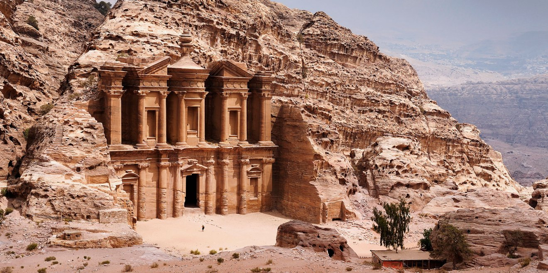
9. WHERE CAN YOU FIND THE LOST CITY OF PETRA?
A) ISRAEL
B) PALESTINE
C) JORDAN
D) ARMENIA

Slide 39
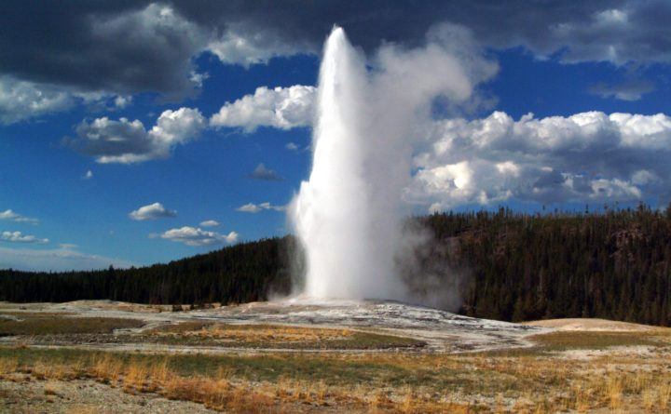
10. WHERE IS THIS NATURAL WONDER?
A) YELLOWSTONE NATIONAL PARK
B) GREAT SMOKY MOUNTAINS NATIONAL PARK
C) YOSEMITE NATIONAL PARK
D) DENALI NATIONAL PARK

Slide 40
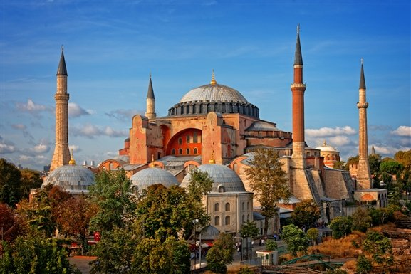
11. IT’S MORE IMPRESSIVE INSIDE THAN OUTSIDE. WHAT IS IT?
A) DOME OF THE ROCK
B) HAGIA SOPHIA
C) SHRINE OF THE BAB
D) THE GOLDEN TEMPLE

Slide 41
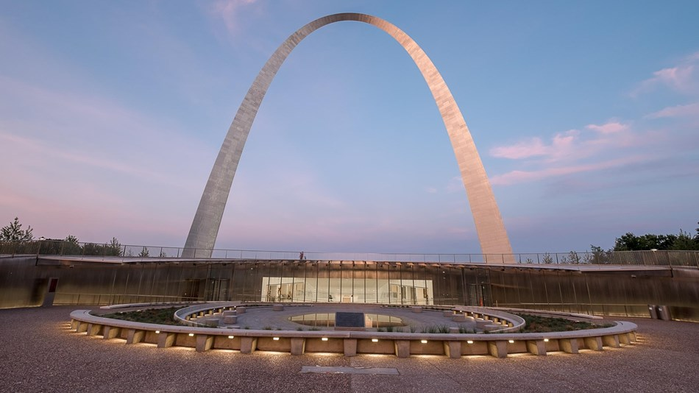
12. WHICH CITY BOASTS THE GATEWAY ARCH?
A) NEW ORLEANS
B) MONTREAL
C) ST. LOUIS
D) KANSAS CITY

Slide 42
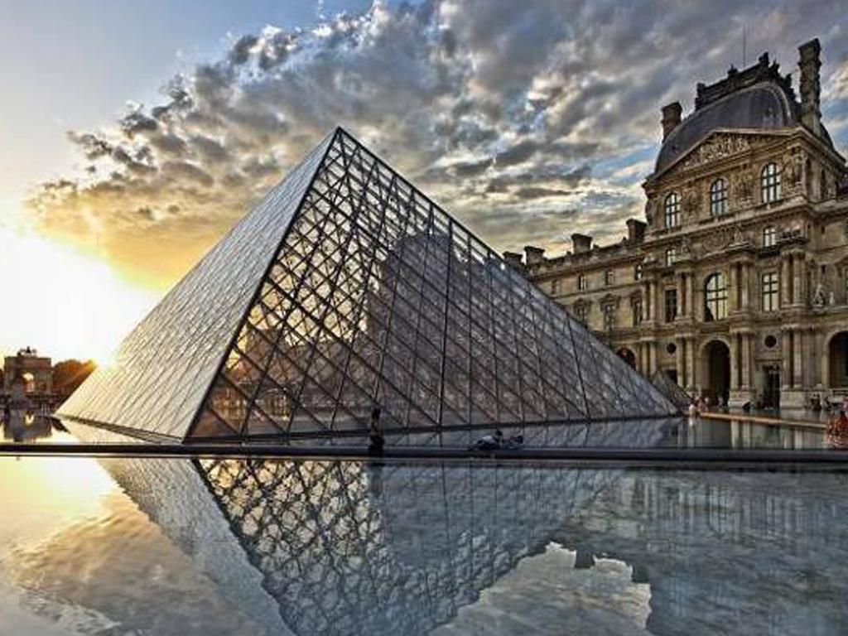
13. WHICH MUSEUM HAS A GLASS PYRAMID IN FRONT?

Slide 43
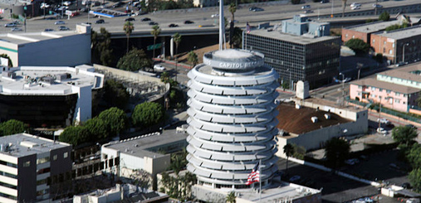
14. WHO USES THIS FAMOUS LA OFFICE BUILDING?
A) MOVIE COMPANY
B) REAL ESTATE DEVLOPER
C) MODELLING AGENCY
D) RECORD COMPANY

Slide 44
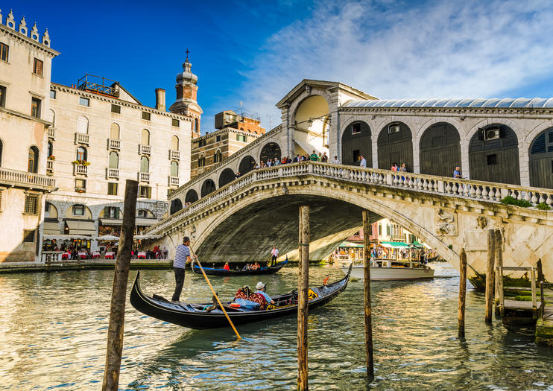
15. WHERE IS THE RIALTO BRIDGE?

Slide 45
THAT’S ALL FOLKS!

